Slide 1
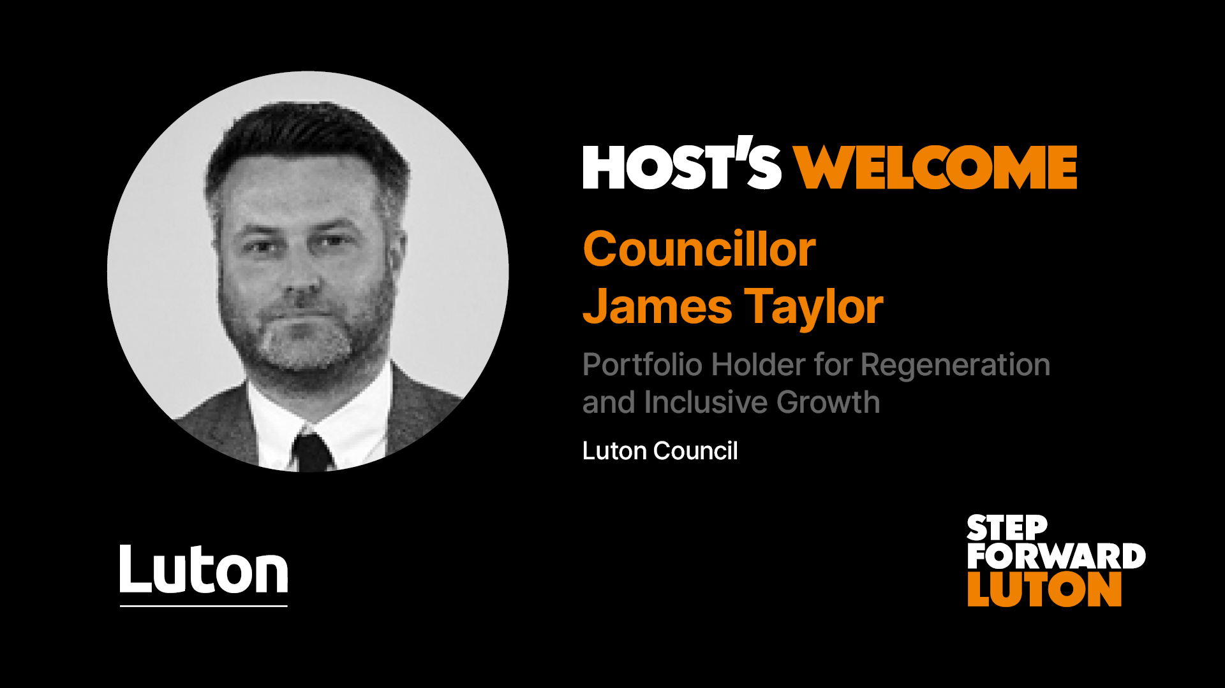
RADIO 1 BIG WEEKEND IN LUTON
OPPORTUNITIES FOR YOUR BUSINESS

Slide 2
WELCOME AND INTRODUCTION
Sinead McNamara, Service Director for Inclusive Growth at Luton Council

Slide 3


Slide 4

Business Support Programmes
Luton Online: Digital Marketing now live
Sustainability Business Support Programmes now live
Capitalising on local opportunities coming soon
Expansion through Global Markets coming soon
For more information please visit:
invest.stepforwardluton.co.uk/business-support/

Slide 5
TRAFFIC MANAGEMENT PLANS
Ben Bodsworth, BT Events
and
Mark Aaronson, Service Manager for Highways Maintenance and Network Management at Luton Council

Slide 6
Background
Friday 24th May to Sunday 26th May 2024
Objectives
Minimise where possible disruption to the local businesses and residents
Maintain a safe environment for residents, public and visitors
Utilise Traffic Management techniques, signage and stewarding to create safe travel corridors
Liaise with all key stakeholders including the Local Authority, Police and other Statutory Bodies
Communicate plans with residents and community groups in advance of the event
 | Opening Times | Live Music Ends | Premises Closes | Zone Ex Core* Operational Times
Headliner: | Chase & Status
Friday 24th May | 14:00 | 23:00 | 23:30 | 09:00 – 02:00
Headliner: | RAYE
Saturday 25th May | 10:30 | 22:00 | 23:00 | 08:00 – 01:00
Headliner: | Coldplay
Sunday 26th May | 10:30 | 22:00 | 23:00 | 08:00 – 01:00

Slide 7
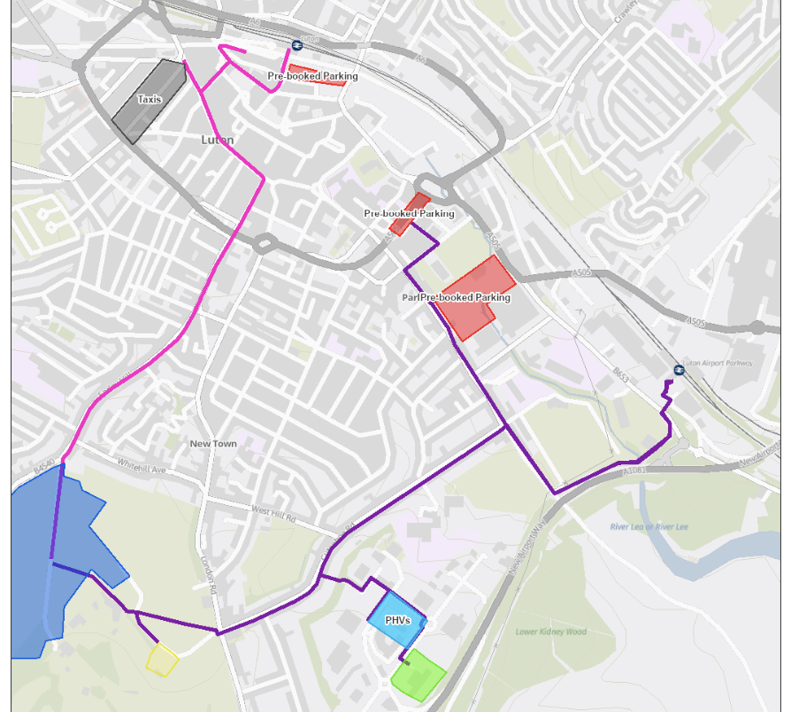
Main Walking Routes

Slide 8
Pick Up/ Drop Off Capabilty Green

Slide 9
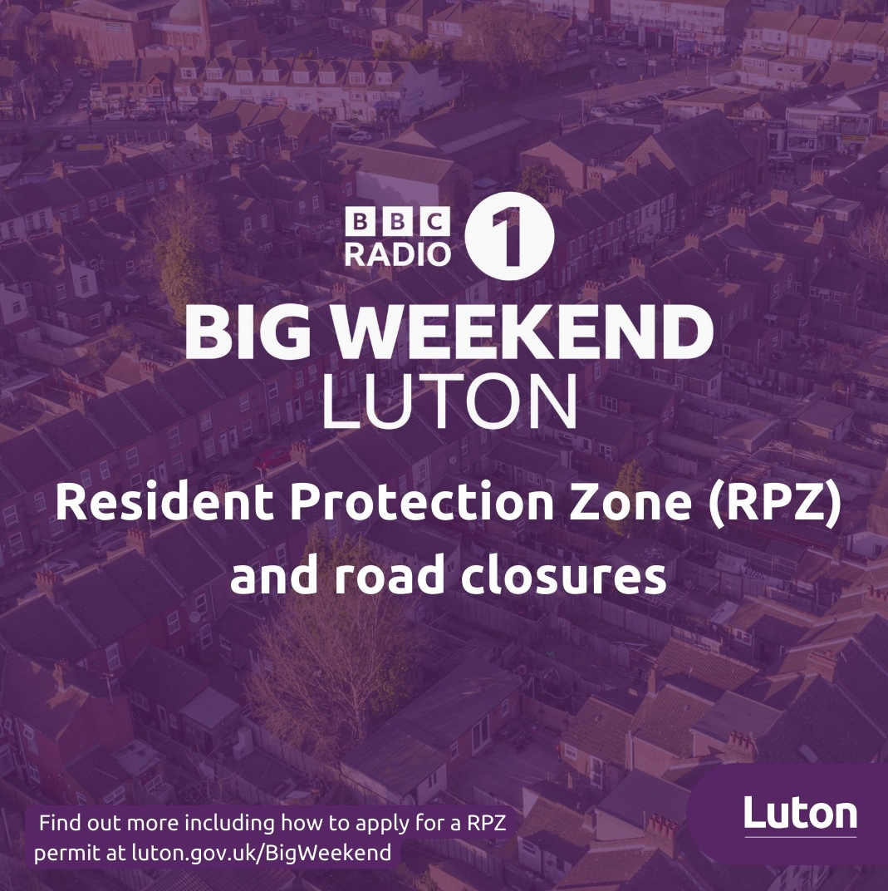

Slide 10
Road Closures
Timings
Friday
09.30 until 01.30 approx. – phased across area
Saturday & Sunday
07.00 until 00.30 approx. – phased across area

Slide 11
Closure Definitions
Road Closure – Road Closed to all traffic except for Blue Light Services
Residential Protection Zone – Road closed to those without a resident permit
Clearway – No Stopping / Waiting / No on Street Parking

Slide 12
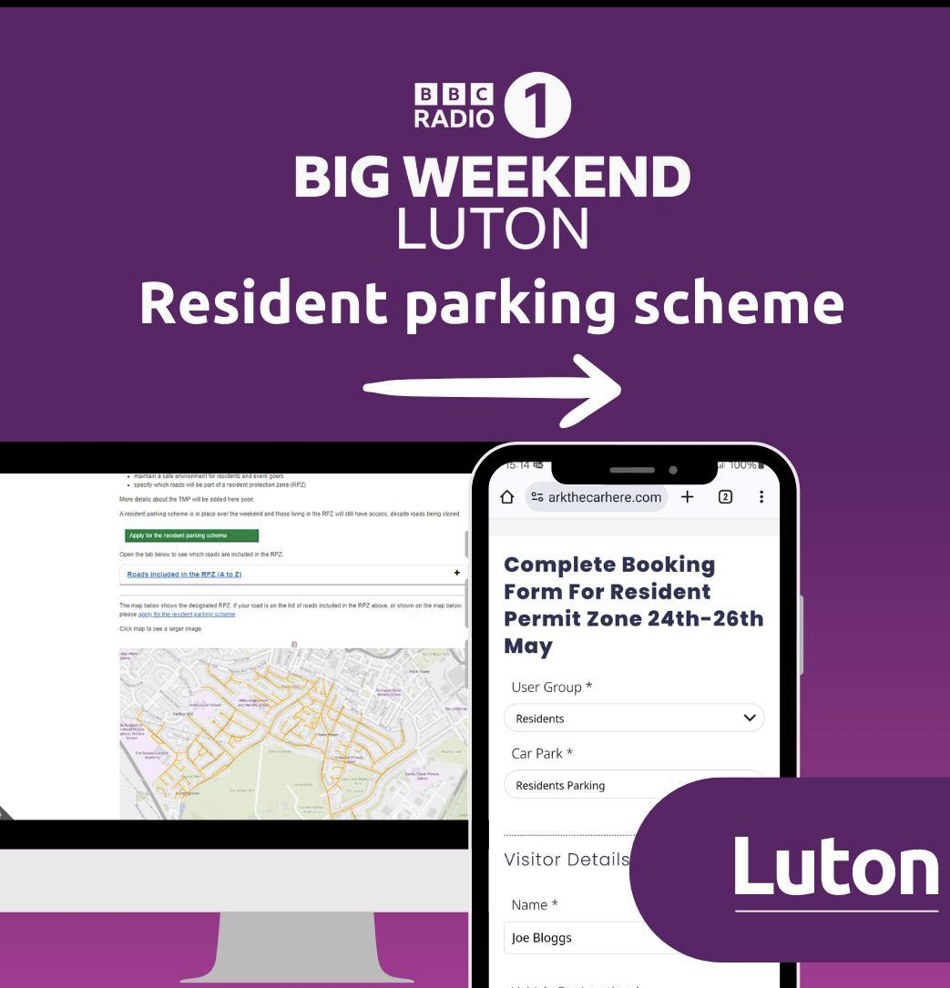

Slide 13
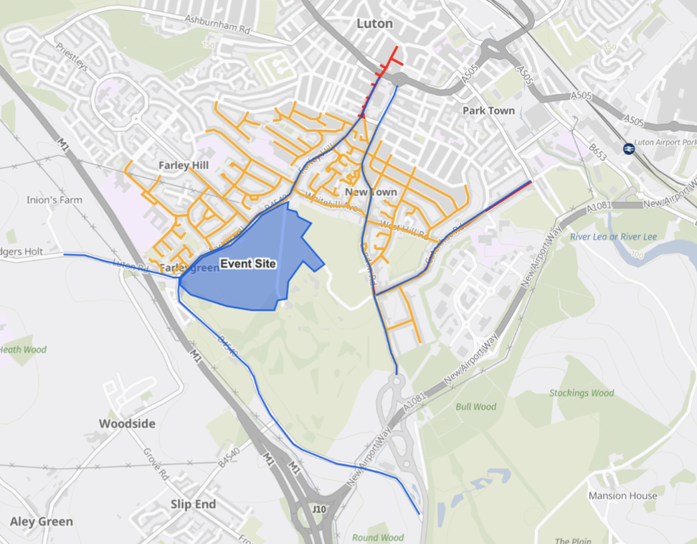
Residential Protection Zones

Slide 14
Permitting Scheme
Resident Protection Zones will be managed with road closures and staff to allow resident access only, deterring unauthorised parking and the blocking of residential access
To have a primary digital application process
Other accessible options for application will be made available
Virtual permits will be issued to the residents' vehicles
Staff at barriers will have scanning devices to check vehicles wanting to access the zone
Radio communications will also be available to the control room to deal with any unexpected requests for access
Provision will be made for carers and health services to residents

Slide 15
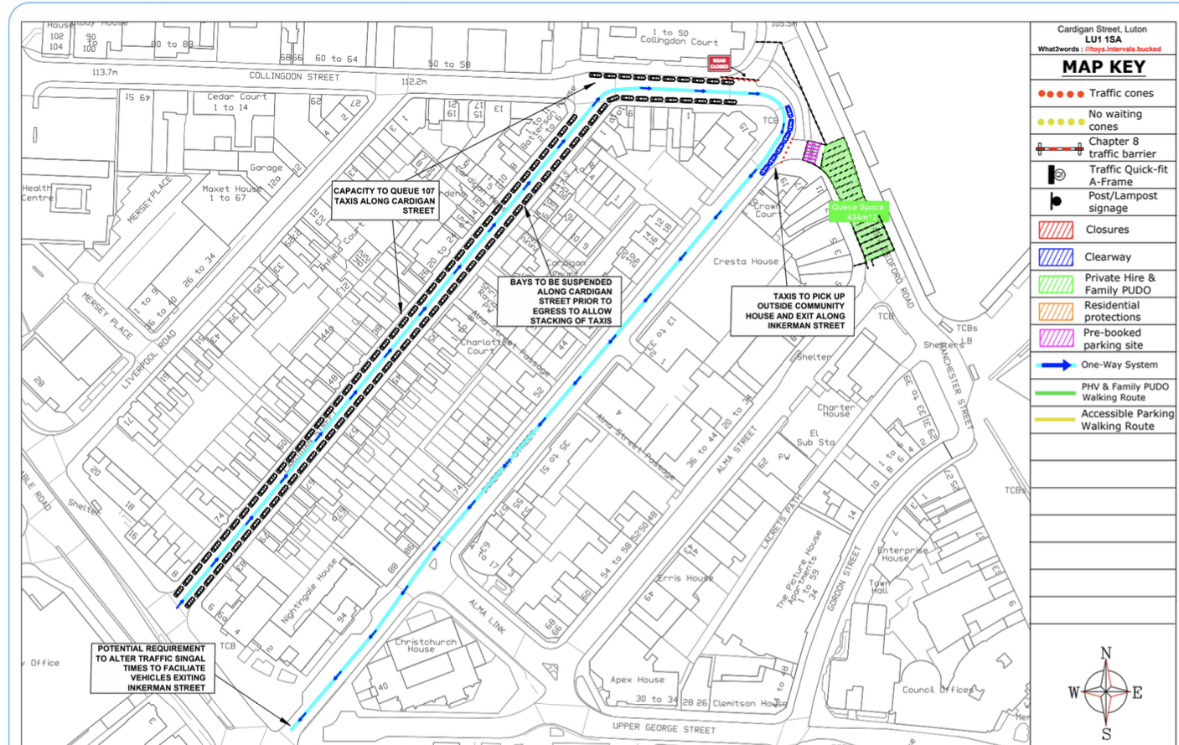
Hackney Carriage/ Private Hire

Slide 16
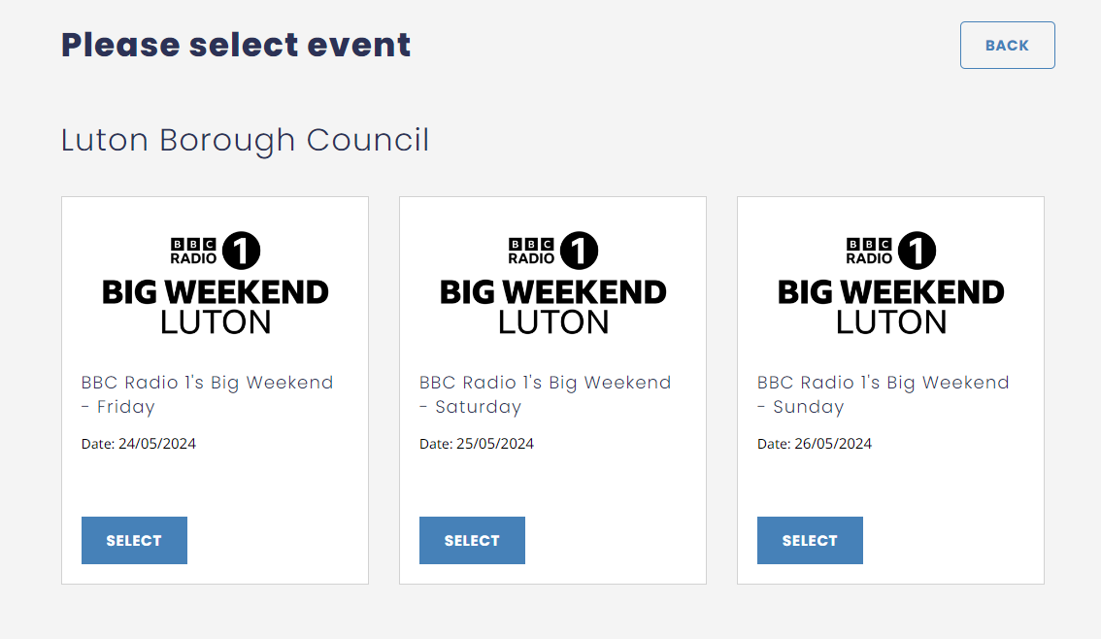
Pre Booked Parking

Slide 17
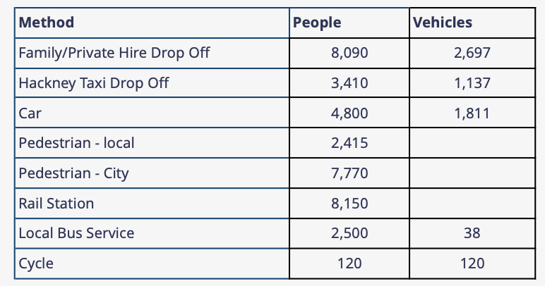
Modes of Travel
town wide

Slide 18
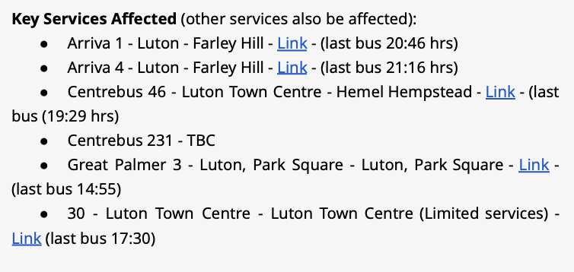
Bus Services
Some disruption to bus services, but services via London Road will be maintained

Slide 19
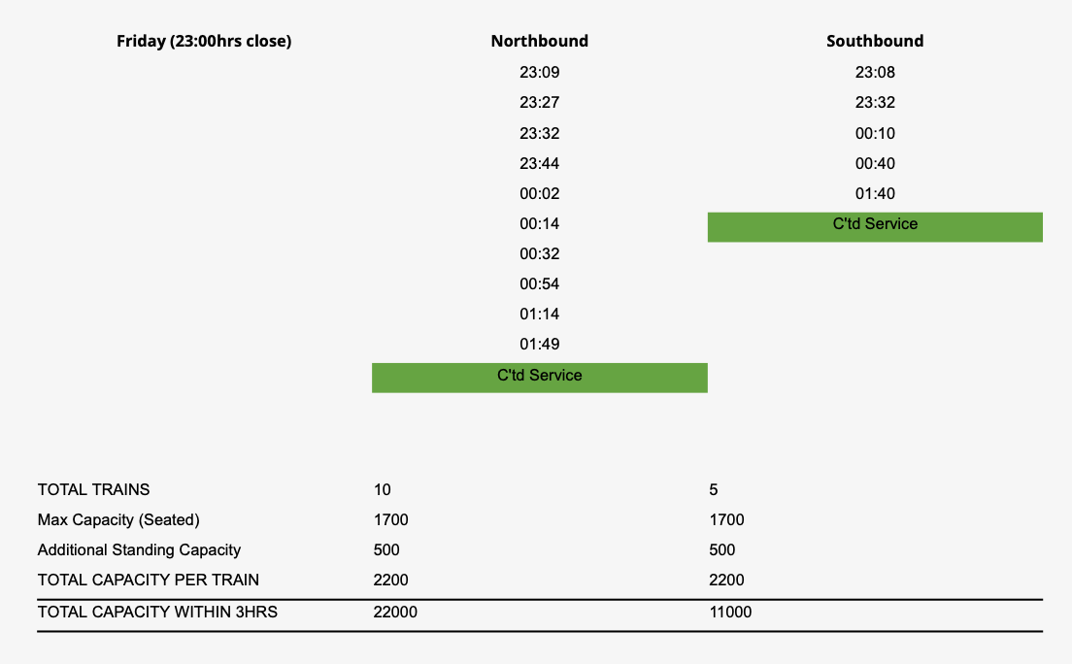
Train Services
Luton Central - Friday

Slide 20
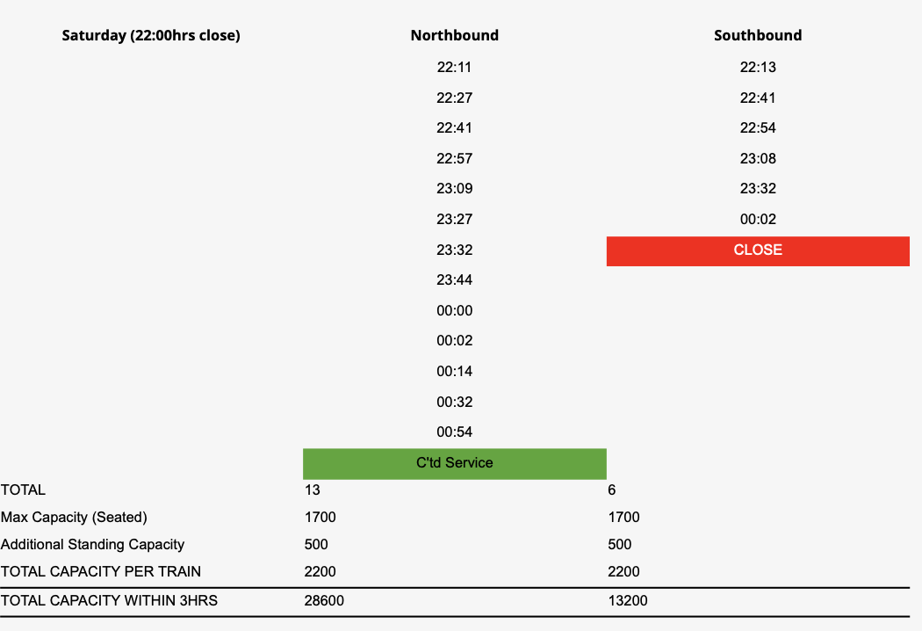
Train Services
Luton Central - Saturday

Slide 21
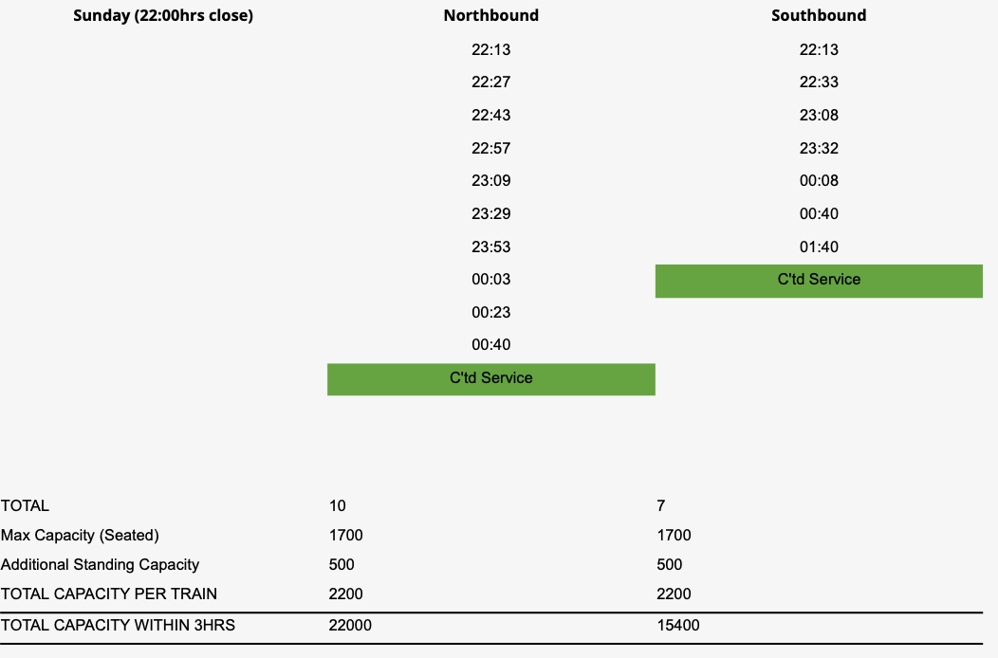
Train Services
Luton Central - Sunday

Slide 22
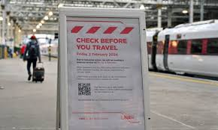
Contingency Plans
Rail Strike
Rail disruption
Displaced Persons
Road Network

Slide 23
Questions
Tony Ireland
Head of Public Protection
Luton Council

Slide 24
FRINGE EVENTS, ACTIVATION AND MARKETING
Corey Albone, Head of Place Activation at Luton Council

Slide 25



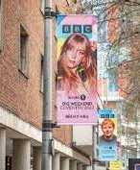

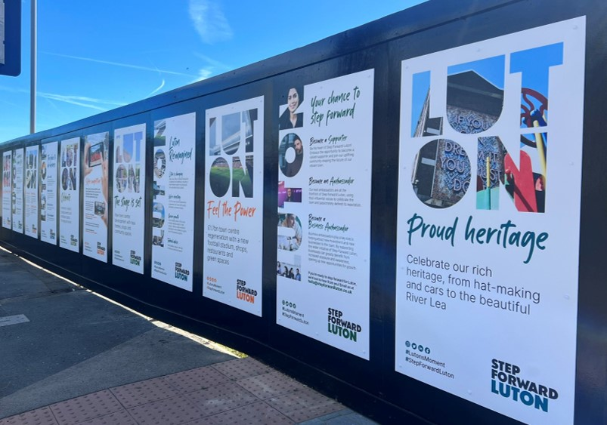
Town Dressing

Slide 26
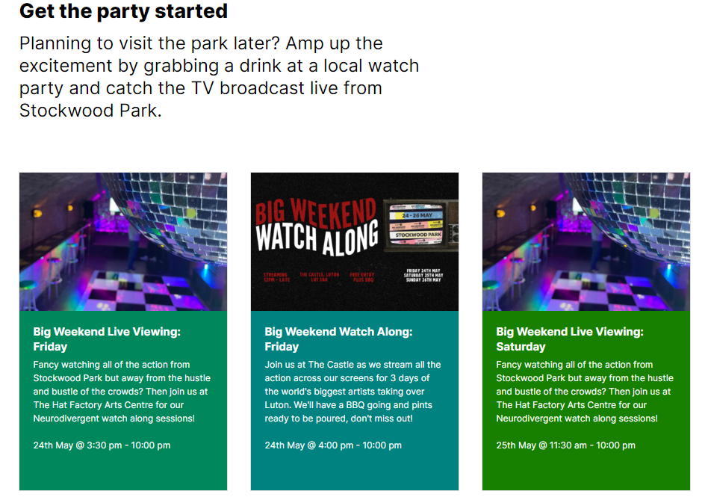
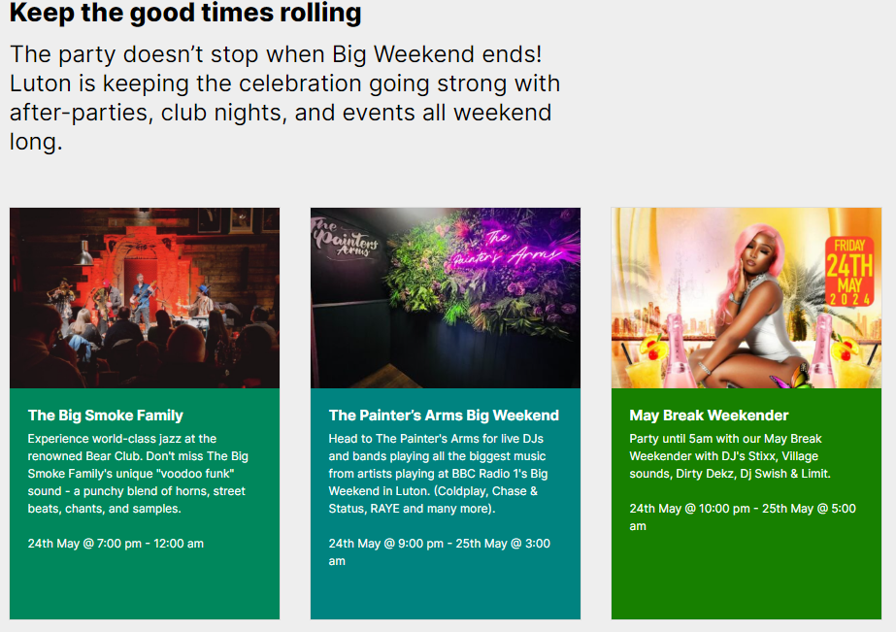
Fringe Events and Activation
https://place.stepforwardluton.co.uk/things-to-do-in-luton/big-weekend-2024/plan-your-visit

Slide 27
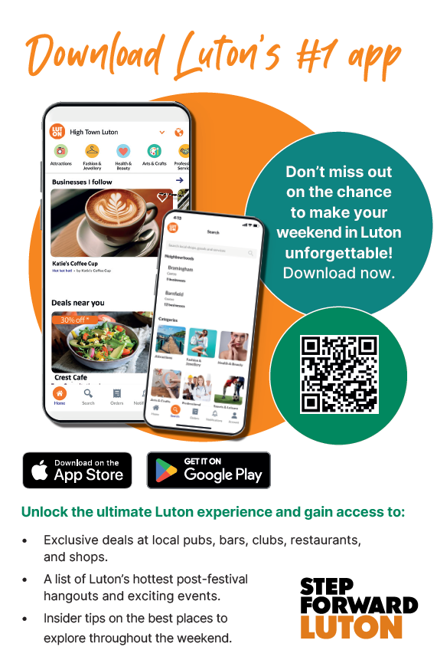
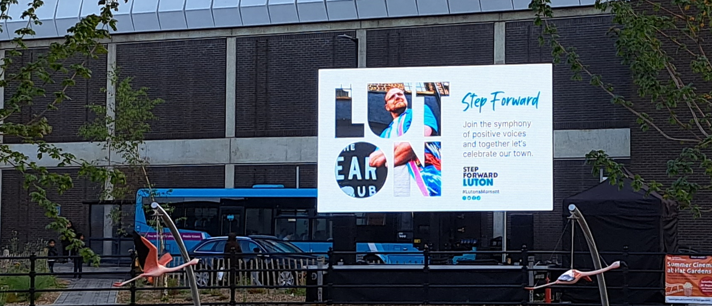
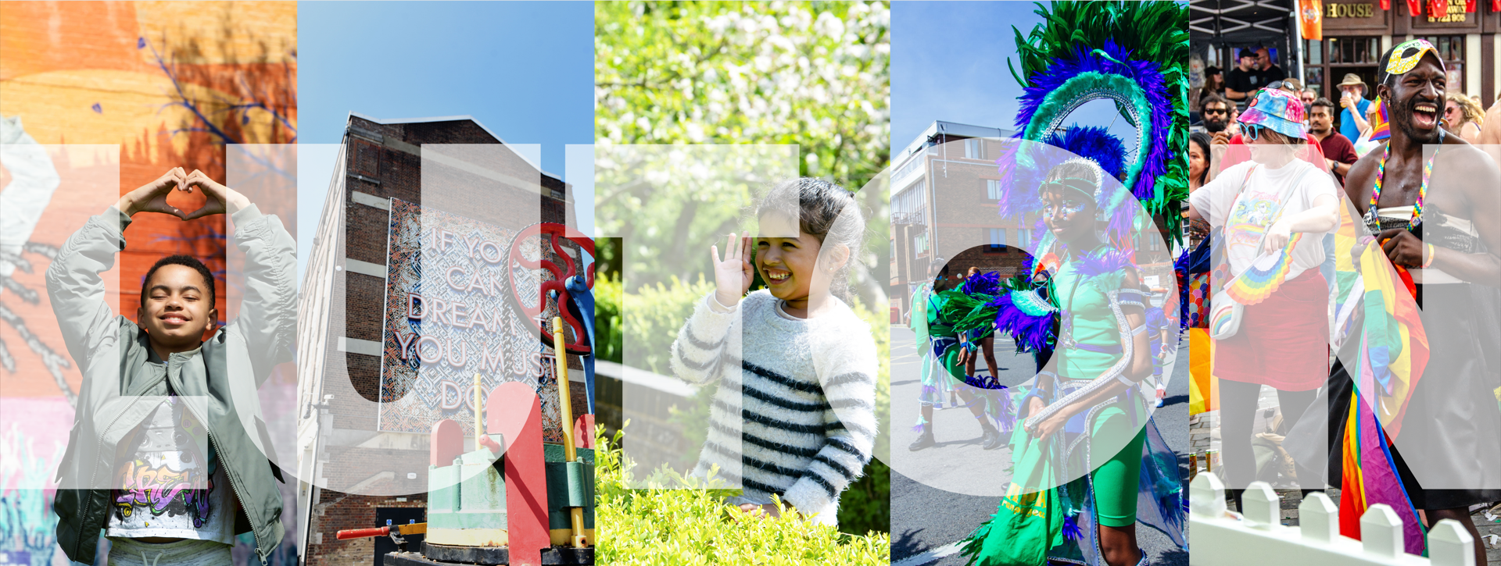

Slide 28

INTRODUCING THE STEP FORWARD LUTON APP
Rosh Ruban, Bubltown

Slide 29


Step Forward Luton
The Mobile App
Powered by

Slide 30

Who is
Bubltown was founded in 2018 with the aim of providing cutting edge technology to businesses who, traditionally, haven’t been able to access it, for a very affordable price.
We then began working with Local Authorities (and won some silverware on the way!)
To date, we have worked with over 15 local authorities and organisations throughout the country; as well as over 3,500 SMEs, like yourselves
We are now working with Luton Council on the, already successful, Step Forward campaign. To bring our technology to the residents and businesses of Luton town and surrounding area

Slide 31
What is Step Forward Luton
Step Forward Luton is a partnership among Luton’s civic, voluntary and business organisations working together to promote Luton as a great place to live, work, invest, visit and study.
With the new partnership with technology provider bubltown, we are bringing Step Forward Luton to small businesses and residents!
The new app will consist of 3 componenents:
1
2
3
The Step Forward Luton App
The bubltown web portal
The bubltown business app
The app residents will use to browse local offers, products and events
Downloadable on the app store and play store
The portal that businesses will use to edit their profile, add offers, products or events
Only available on laptop, desktop or tablet
The portal that businesses will use to edit their profile, add offers, products or events
Only available on laptop, desktop or tablet

Slide 32
How does it work?
Setting up your profile on Step Forward Luton is incredibly easy
For those that struggle with technology, or don’t have the time, we will create the first draft of your business profile for you, as standard
Once you have approved of your draft profile it is time to start to think about the offers you would like to promote on the app
Promoting a walk-in offer on the Step Forward Luton app is also completely free
Please note that there will be a large surge of users on the app for Radio 1s Big Weekend and therefore, you have the highest chance of exposure if your offers are on the app before this date!
We will now go through a quick demo of bubltown’s web portal, to show you all how easy it is!

Slide 33
How can you Join?
Joining Step Forward Luton is completely free!
If you would like to join, please send an email to the following email address:
Please include the following information in your email:
The name of your business
The address of your business
Your name
Your contact number
rosh@bubltown.co.uk

Slide 34
The Big Weekend
As mentioned earlier in this presentation, the app’s launch will be tied around Radio 1s Big Weekend. Therefore, we encourage each business who joins to submit a special “Big Weekend” offer. These offers will be displayed prominently in their own section of the app, as well as being the subject of thousands of pounds worth of marketing efforts!
To submit a Big Weekend offer:
2
bubltown support
Once you have published your profile, you have the option of emailing our support team with the details of your offer, and our team will set the offer up on the system
1
Complete your Business Profile
Press publish on your business profile and we will make it live on the Step Forward Luton app. This is the first step in your Step Forward Luton journey and must be completed before anything else can be done
2
Self-serve
If you are feeling confident, once you publish your profile, just visit the “campaigns” section of the web portal and you can set your offer up yourself.

Slide 35

We want feedback from all BID businesses. Please make sure you have your say. See us for a survey or email us at info@lutonbid.org.

Slide 36
For more information:
On marketing opportunities for your business contact: Corey.Albone@luton.gov.uk
Sign up to the Step Forward Luton app by emailing: rosh@bubltown.com
On traffic management or other enquiries about the event: BigWeekendEnquiries@luton.gov.uk or visit https://invest.stepforwardluton.co.uk/big-weekend-opportunities/
On the Luton BID Survey contact: info@lutonbid.org
For more useful information for your business sign up to our newsletter: https://invest.stepforwardluton.co.uk/sign-up/

